Slide 1
MAVEN
By surya and haritha

Slide 2
INDEX:
WHAT IS MAVEN?
MAVEN LIFE CYCLE
PHASES OF MAVEN
GOALS OF MAVEN
ADVANTAGES OF MAVEN

Slide 3
WHAT IS MAVEN?
Maven is like a project manager for software development. It organizes the project’s structure, tracks dependencies (like materials and tools), and handles the build process. Maven coordinates the compilation, testing, and packaging of your code. It saves time by automatically resolving dependencies from repositories

Slide 4
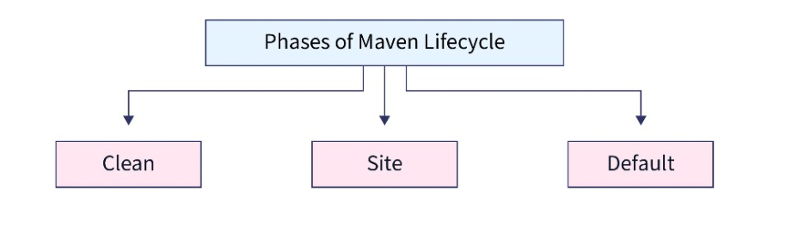
MAVEN LIFE CYCLE: The Maven build follows a specific lifecycle to deploy and distribute the target project.
There are three built-in lifecycles:

Slide 5
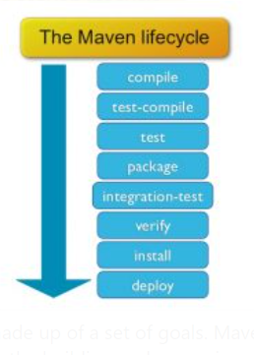
PHASES OF MAVEN:

Slide 6
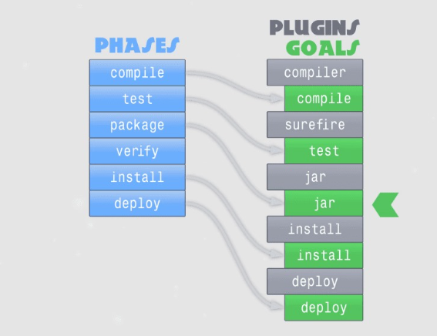
GOALS OF MAVEN:
A build phase is made up of a set of goals. Maven goals represent a specific task that contributes to the building and managing of a project. Sometimes, a maven goal is not bound to a build phase. We can execute these goals through the command line.

Slide 7
ADVANTAGES OF MAVEN:
Standardized build process
Dependency management
Project lifecycle framework
Extensible with plugins
Central repository system

Slide 8
THANK YOU

